Slide 1

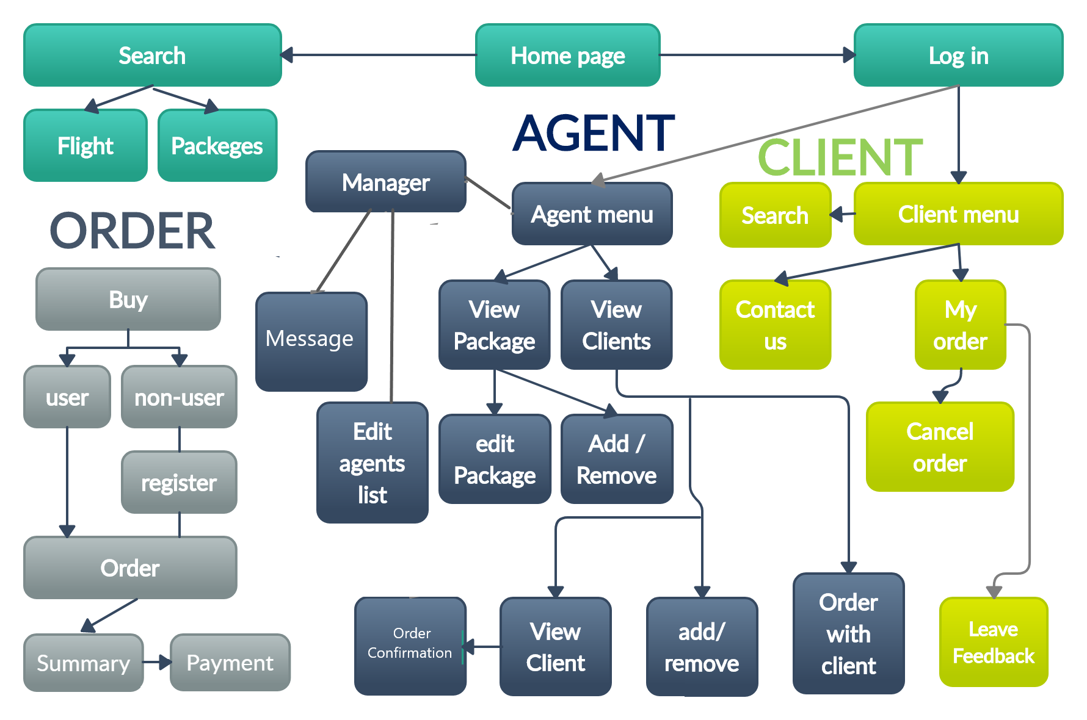
PACK4U
Travel Agency
The purpose of this project is to provide the company a organizational ability and efficient way to manage the company transactions, by developing a user-friendly booking management system.
We present you a prototype of our system.
RESPONSIVE MAP
Visit site

Slide 2


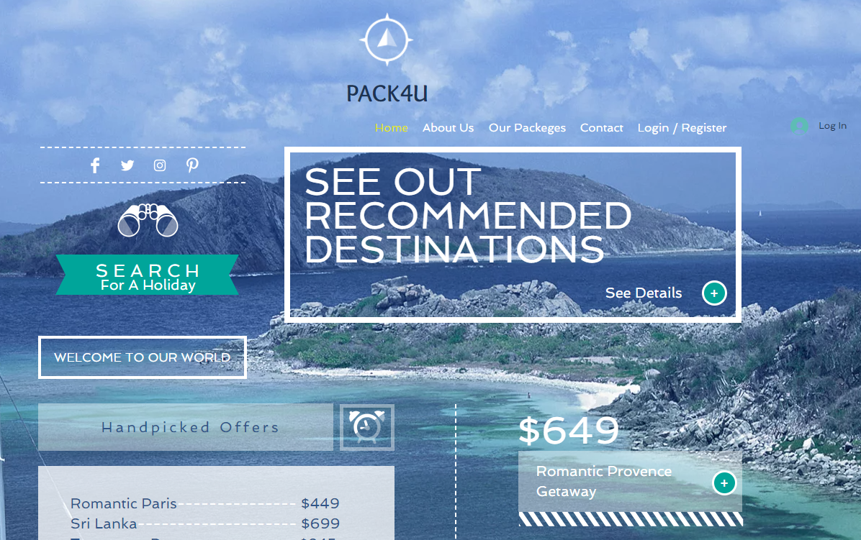
HOME PAGE
Visit site
Back to map

Slide 3
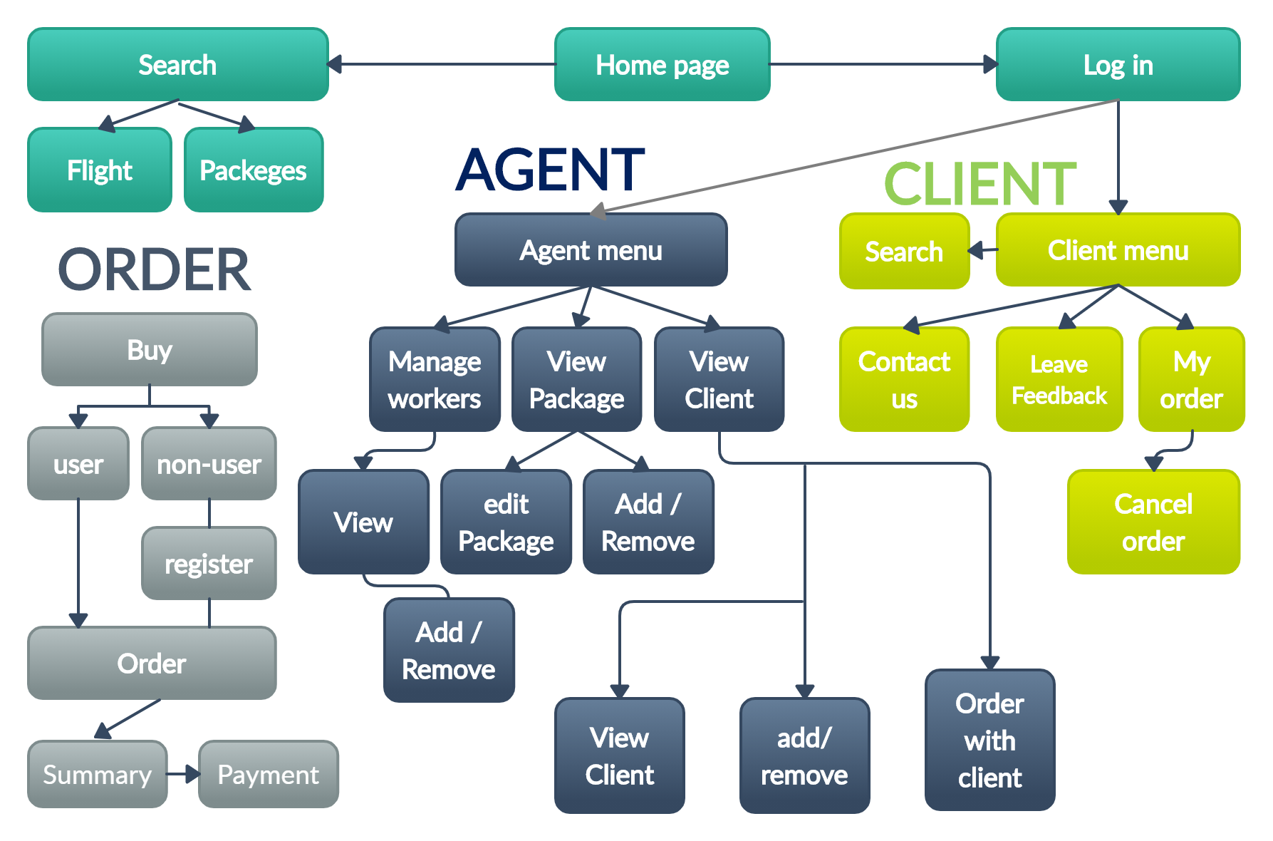
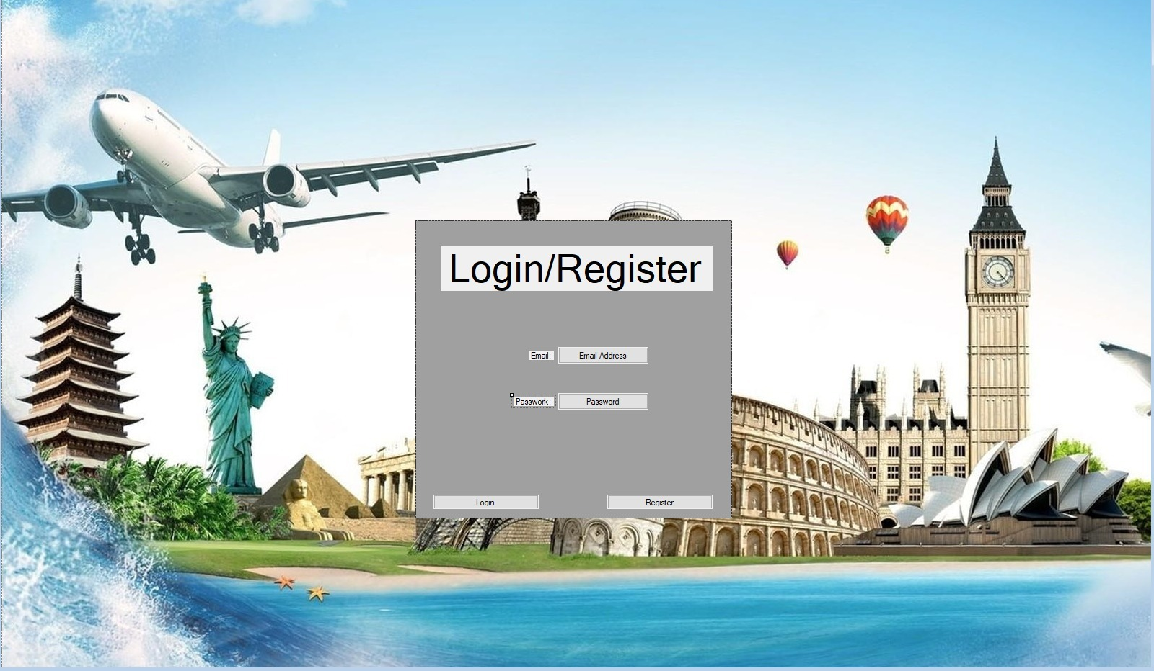
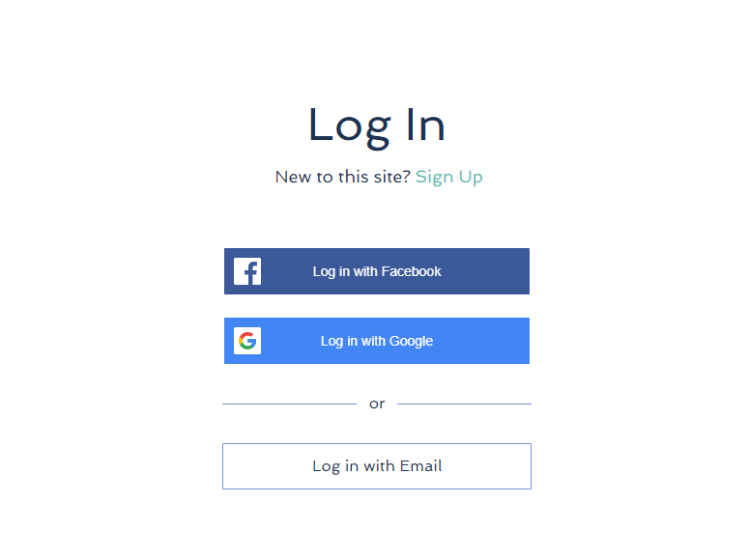


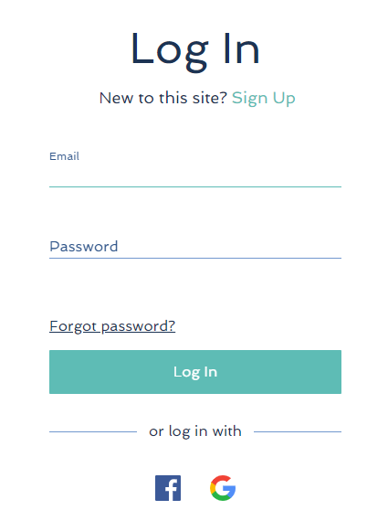
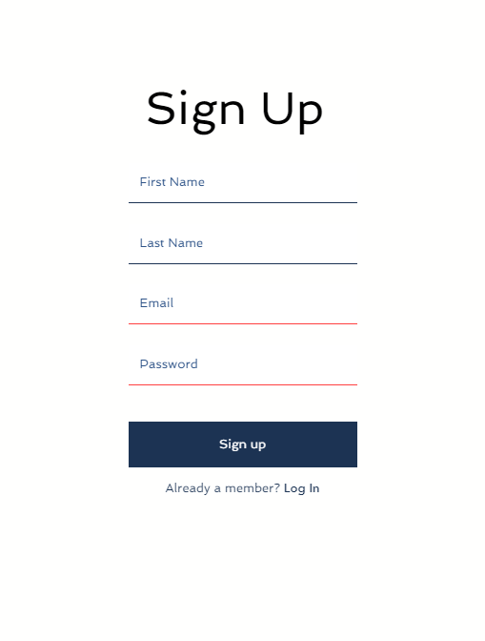
LOGIN /REGISTER
Visit site
Back to map

Slide 4
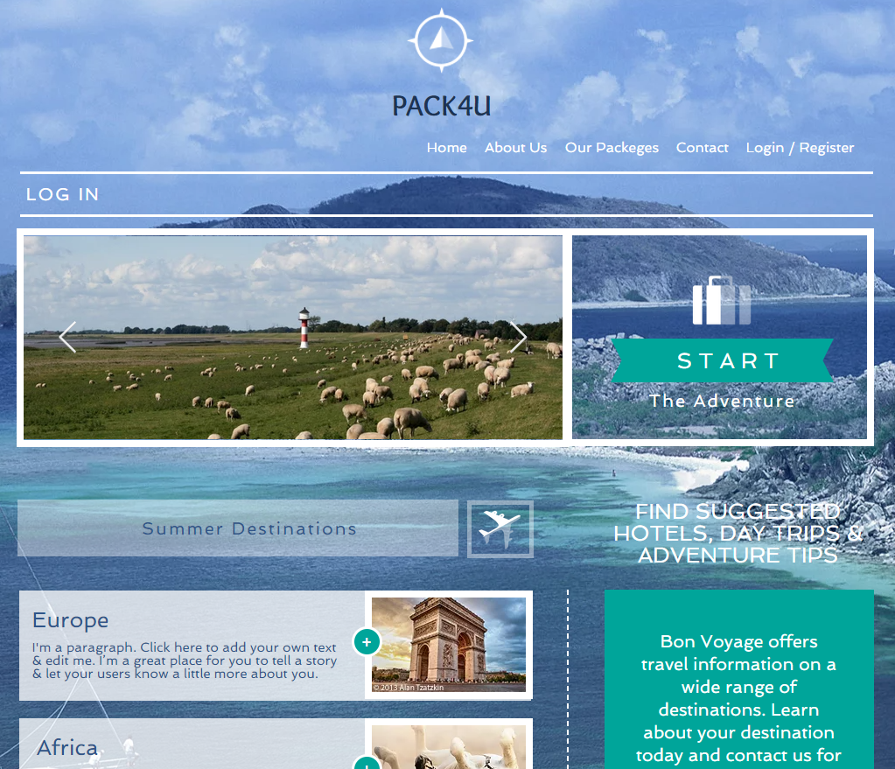
Search
-here the client can find packages and flights, by categories.
View site
Back to map

Slide 5
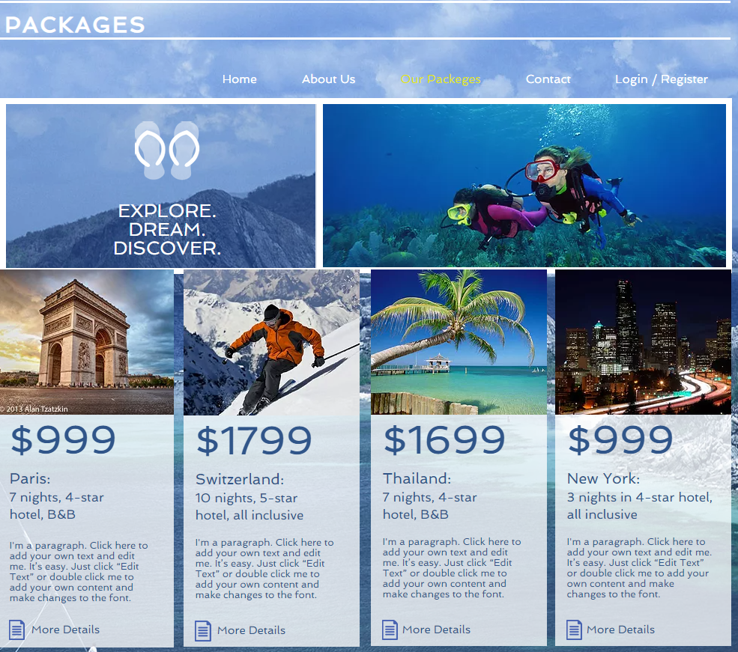
Packages
-here the client can view recommended and discounted packages.
View site
Back to map

Slide 6
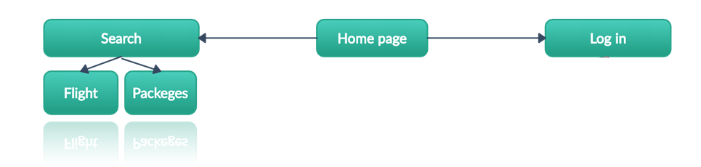
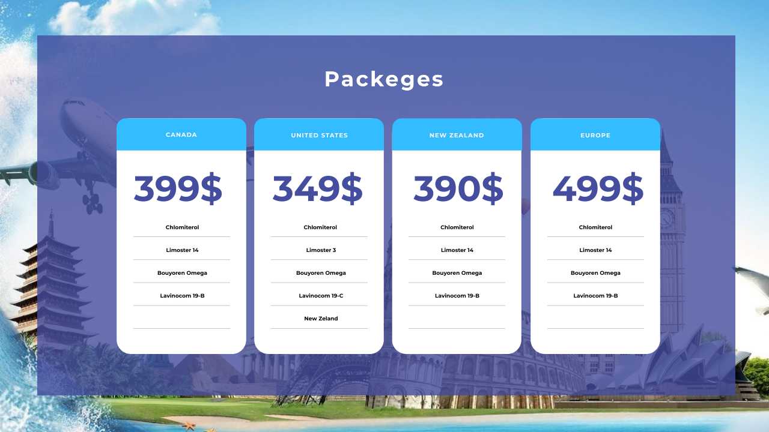
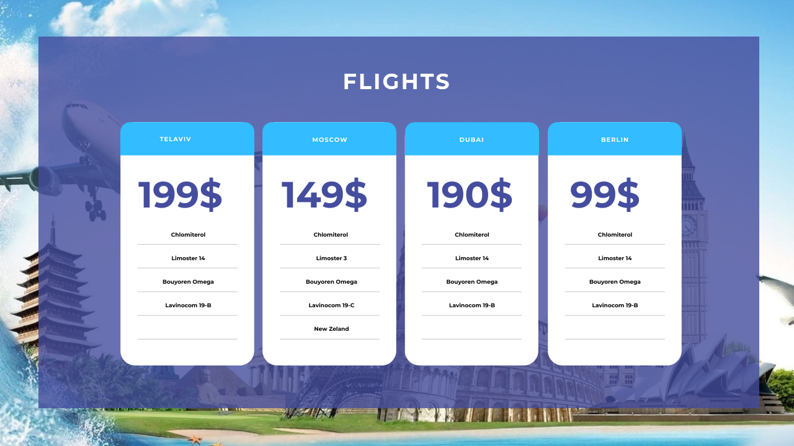
FLIGHTS
Visit site
Back to map

Slide 7
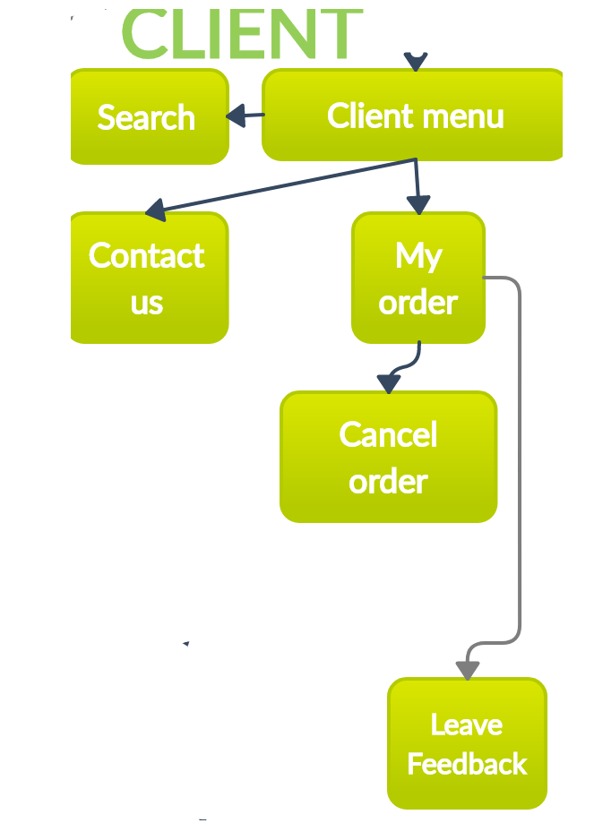
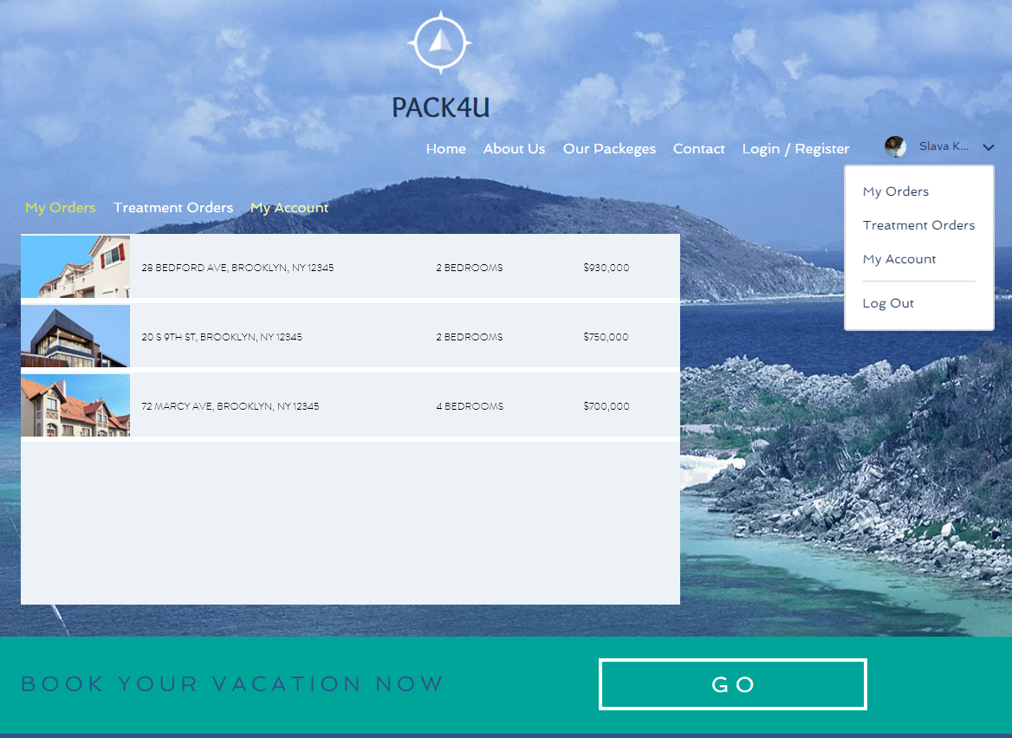
CLIENT MENU
View site
Back to map

Slide 8
SEARCH
View site
Back to map

Slide 9
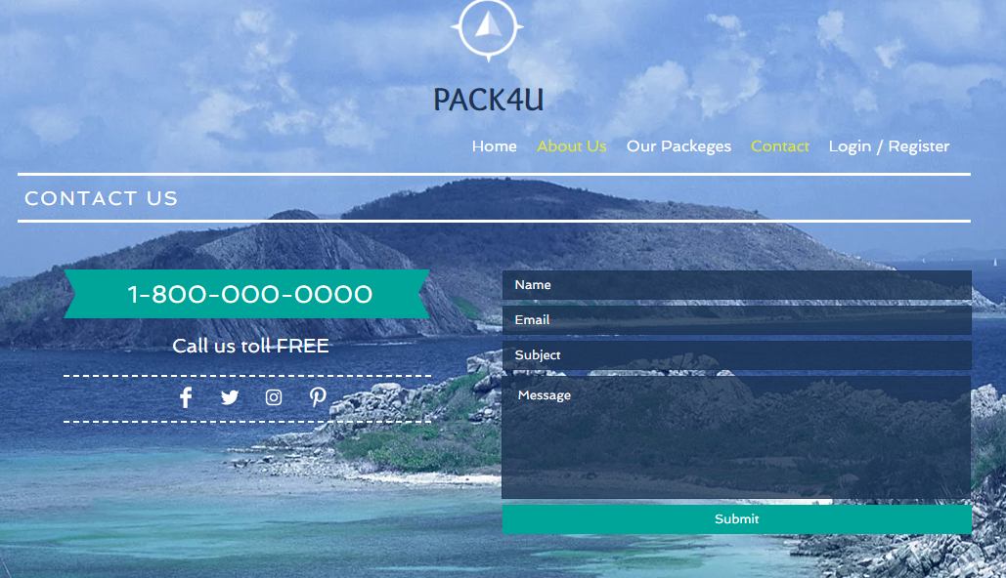
CONTACT US
View site
Back to map

Slide 10
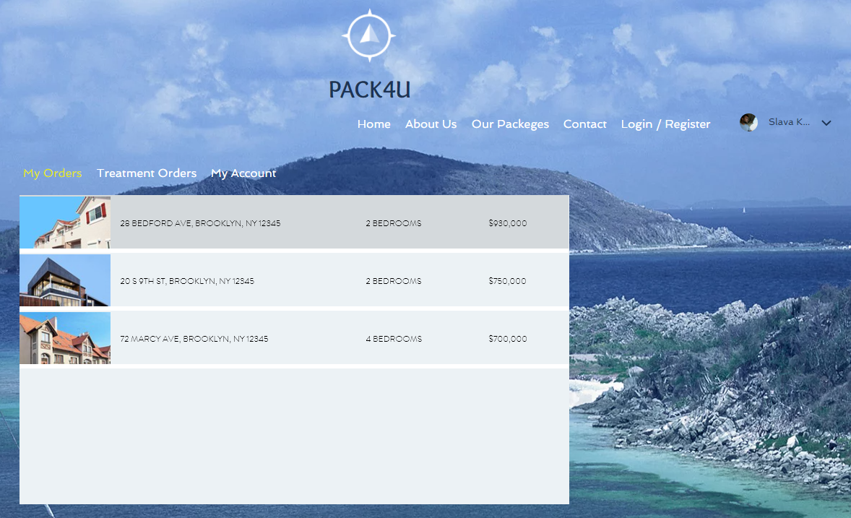
MY ORDERS
View site
Back to map

Slide 11
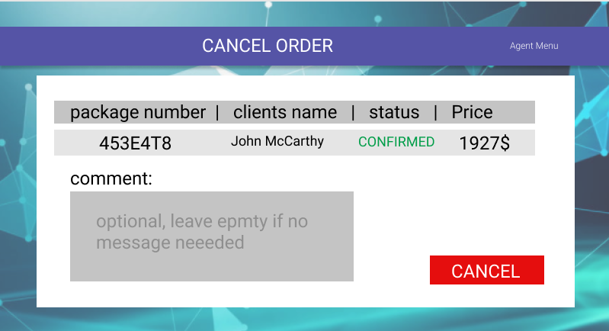
CANCEL ORDER
View site
Back to map

Slide 12
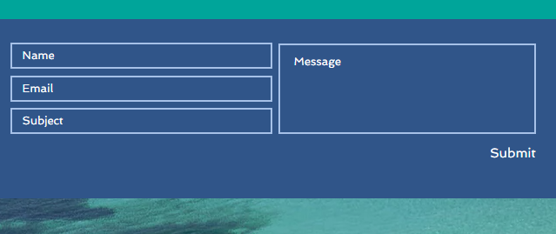
LEAVE A FEEDBACK
Rate this product:
:-The client can rate the product after the package date
View site
Back to map

Slide 13
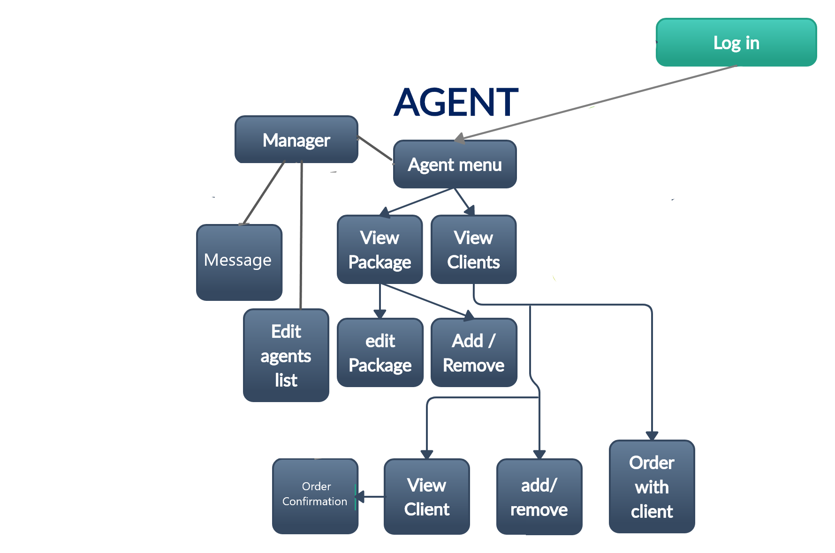
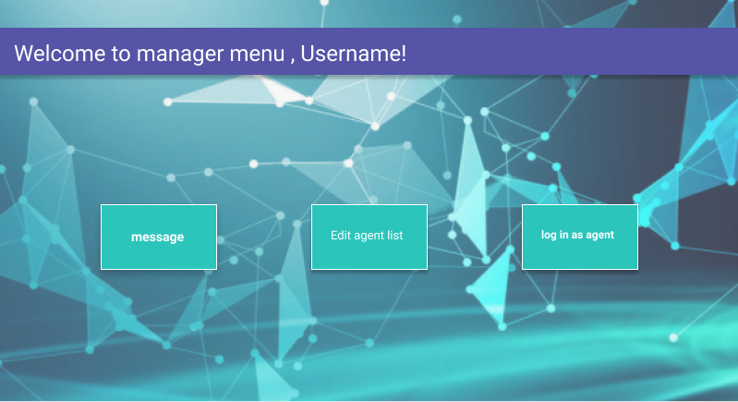
Manager menu
Enter as agent
Visit site

Slide 14
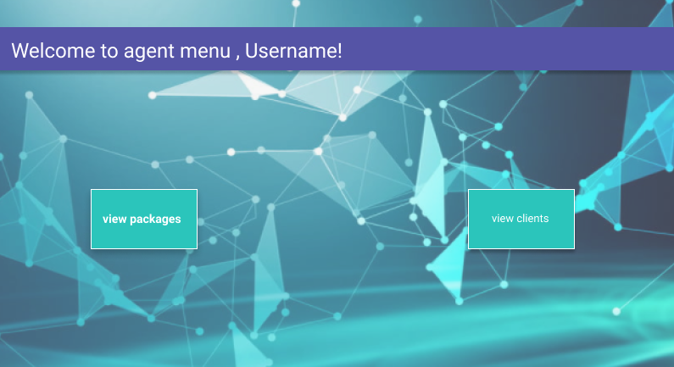
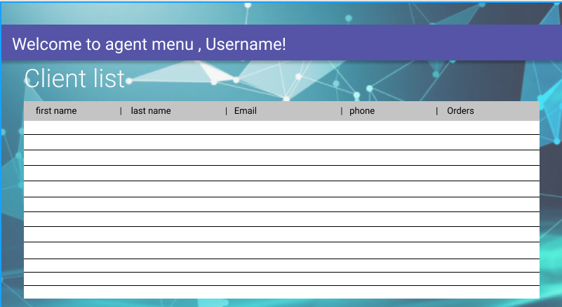
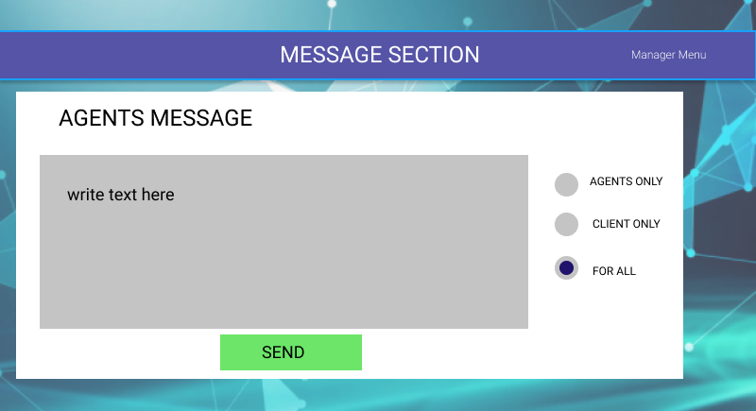
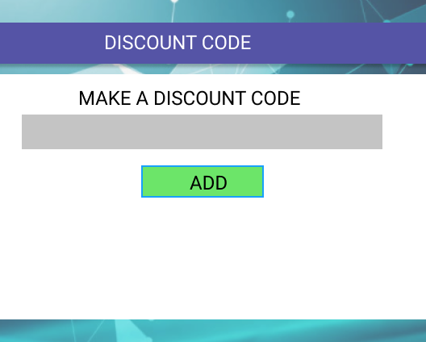
MESSAGE/DISCOUNT
-here manager can send messages, create and send discounts.
Visit site
Back to map

Slide 15

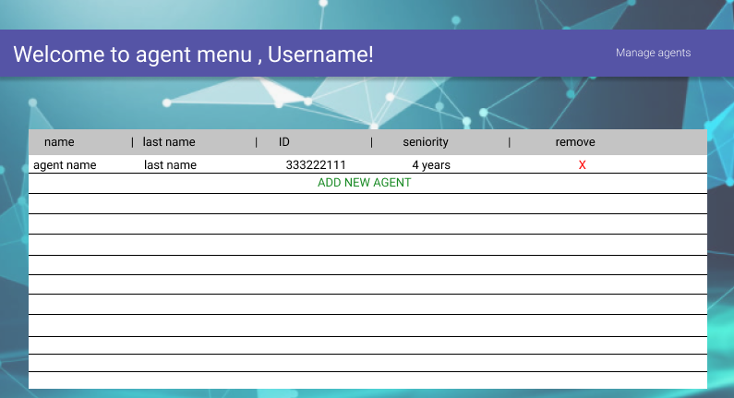
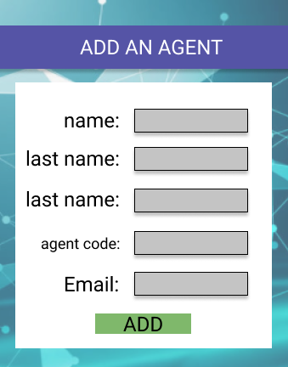
Manager menu
Visit site
Back to map

Slide 16
Agent menu
Visit site
Back to map

Slide 17
Client list
Visit site
Back to map

Slide 18

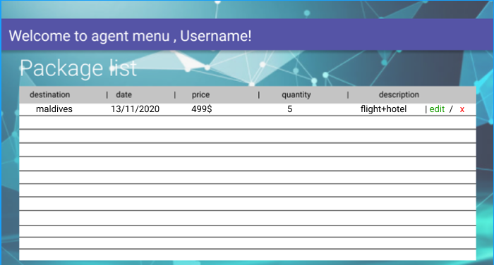
View package
Visit site
Back to map

Slide 19
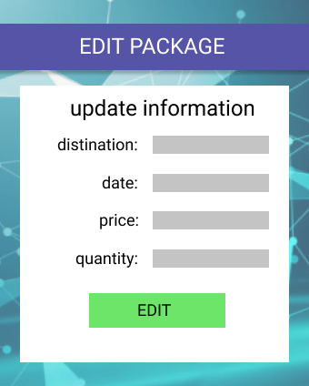
EDIT PACKAGE
Visit site
Back to map

Slide 20
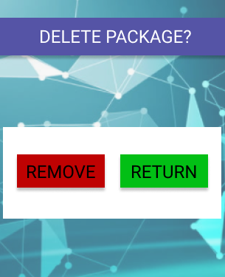
ADD/REMOVEPACKAGE
Add new
Add new package
Visit site
Back to map

Slide 21
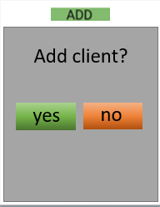

ADD/REMOVE CLIENT
remove
remove
Add client?
Remove client?
yes
no
Visit site
Back to map

Slide 22
Client list
remove
Visit site
Back to map

Slide 23
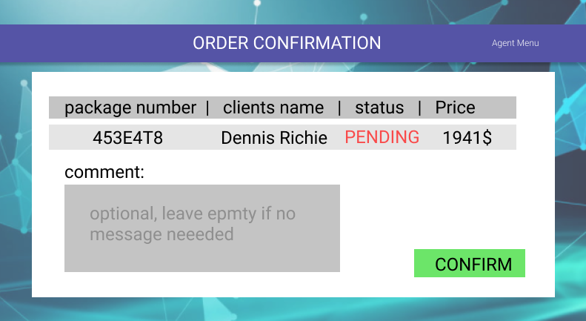
ORDER CONFIRMATION
remove
confirm
Visit site
Back to map

Slide 24
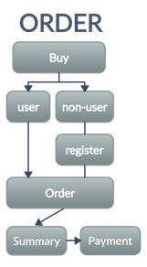
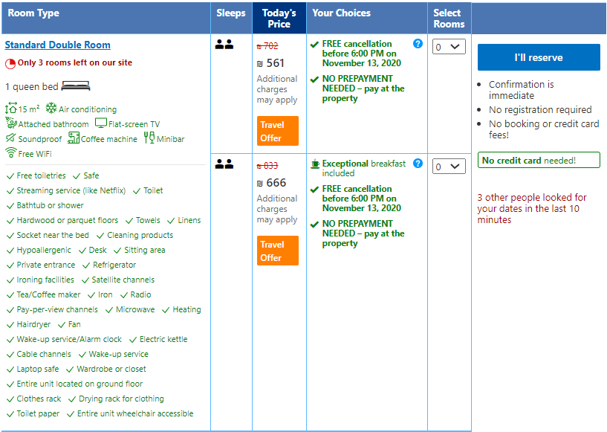
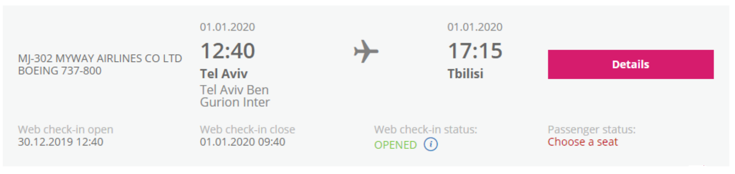
ORDER
Back to map

Slide 25
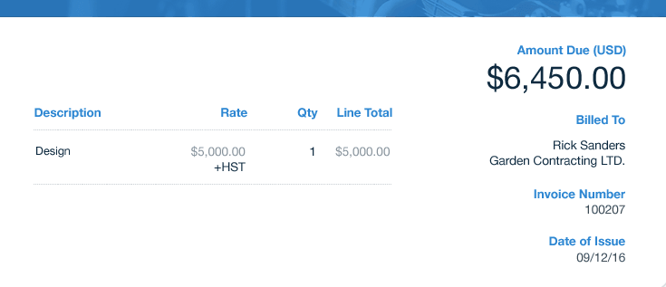

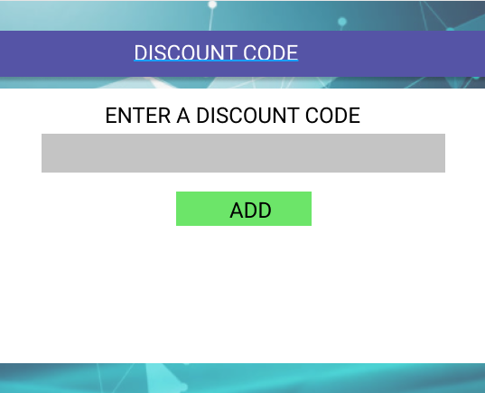
SUMMARY
-here the user can see the final details of the purchase, and use a discount code.
Back to map

Slide 26
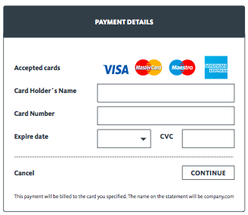
PAYMENT
Back to map

Slide 27
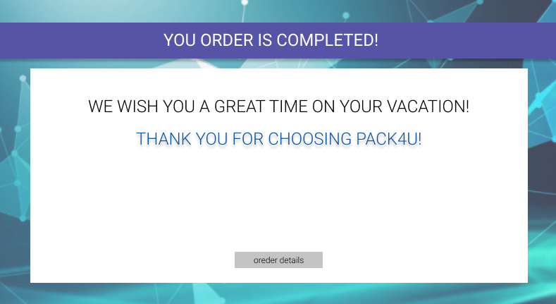
PACK4U
Travel Agency
.
Visit site

